Slide 1
OPCAT Server
Delivery Training
16/3/09

Slide 2
Project Scope
OPCAT Server | 5
Reporting Module | 6
RPG Code Reverse Engineering Module | 10
Categorization | 11
Security | 13
Versioning Module | 14
Change Management Integration | 17
Reporting Enhancements | 17

Slide 3
Our High Level Goals (reminder..)
unify code
less re-write
Reduce implementation cost \ time
Improve Clarity for our customers and team

Slide 4
Objectives and Topics
Introduce OPCAT Server :
    OPCAT Model Control (OMC)
    Reuse and Dependencies
Discuss OPCAT Server implications on the design process
Additional reading material can be found at the Server User Guide

Slide 5
Development Basic Flow
V
Change
Request
Design and
Change
the Model
Code Rewrite
in RPG Editor
Automatically
Update
the Model
Notes:
Change request will discuss in details how

Slide 6
Client-Server Work
Designer
OPCAT Server
OPCAT
Client
Repository
Working Copy
Model
Model
OPCAT
Client
Model
OPCAT
Client
Working Copy
Working Copy

Slide 7
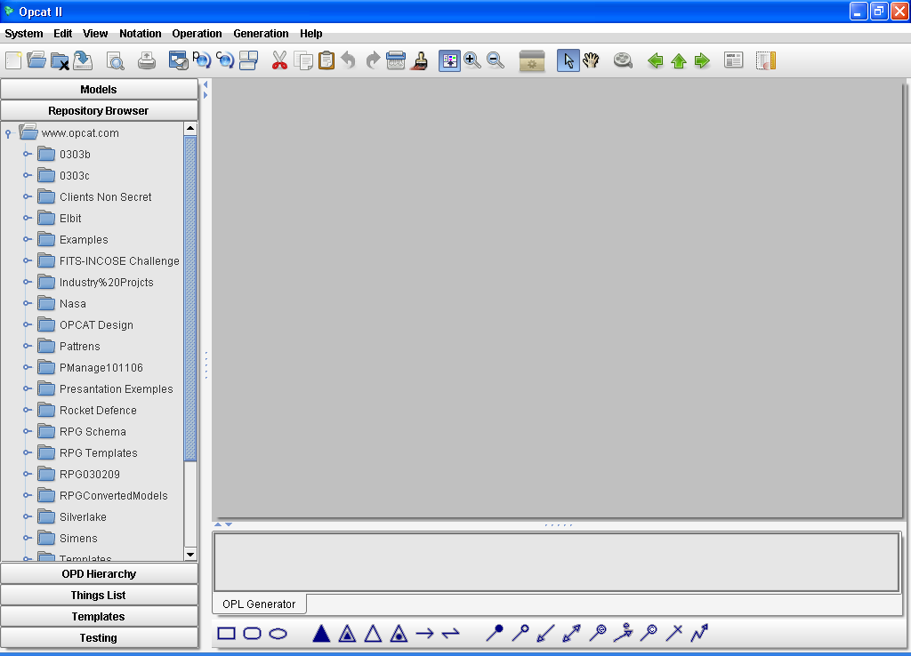
Repository Browser
The Models are stored on the central server
Notes:
Prepare Directory for each person with one file under his name
“Show Properties”
“Checkout
Directory “Chen” with Locked and Unlocked

Slide 8
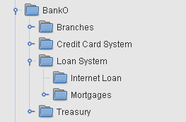
Repository Browser
Models arranged in directories and subdirectories:
  we recommend Sub-System structure
  it shall correspond to the code structure
Notes:
Prepare Directory for each person with one file under his name
“Show Properties”
“Checkout
Directory “Chen” with Locked and Unlocked

Slide 9
Repository Browser
You must have a user name and password in order to see the repository
Notes:
Prepare Directory for each person with one file under his name
“Show Properties”
“Checkout
Directory “Chen” with Locked and Unlocked

Slide 10
Repository Browser
Models can be locked or unlocked
Normal
Locked
Locked By Me
Notes:
Prepare Directory for each person with one file under his name
“Show Properties”
“Checkout
Directory “Chen” with Locked and Unlocked

Slide 11
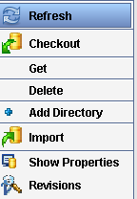
Repository Browser
Repository to Working Copy
Repository Operations
Hands-on
Notes:
Prepare Directory for each person with one file under his name
“Show Properties”
“Checkout
Directory “Chen” with Locked and Unlocked

Slide 12
Client-Server Work
Designer
OPCAT Server
OPCAT
Client
Model
Model
Model
Repository
Working Copy
OPCAT
Client
OPCAT
Client
Working Copy
Working Copy

Slide 13
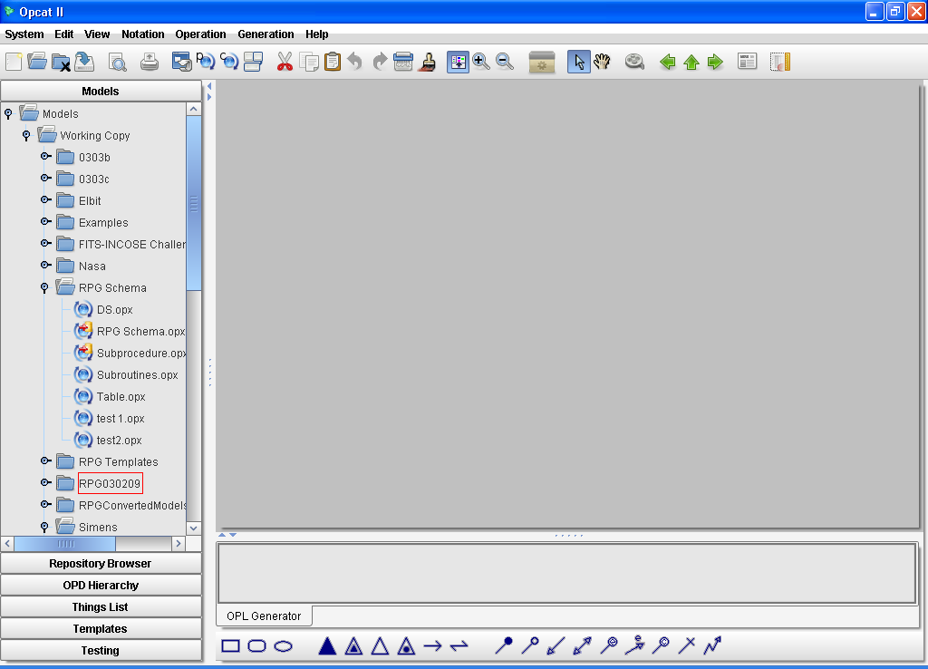
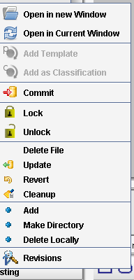
Working Copy
Notes:
Open Model Change
Show Icon
Commit
Delete Locally
Add new file – Add Commit
Have other person change an unlock file – commit – I try to commit
Check out locked file

Slide 14
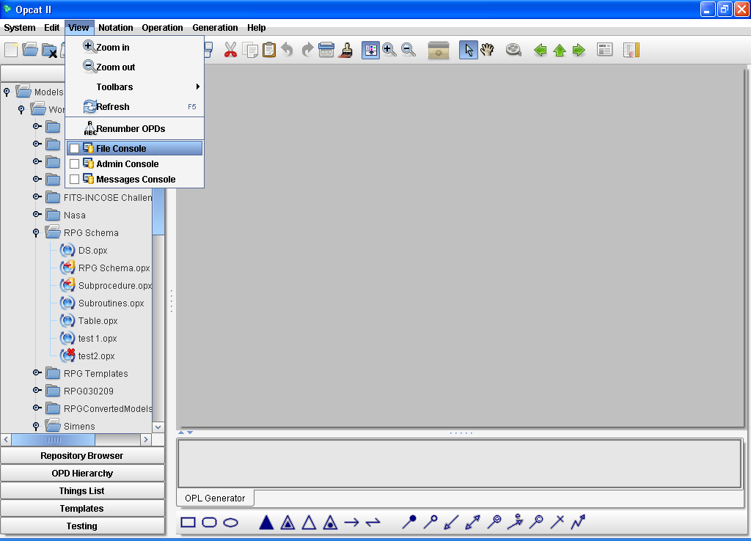
Consoles

Slide 15
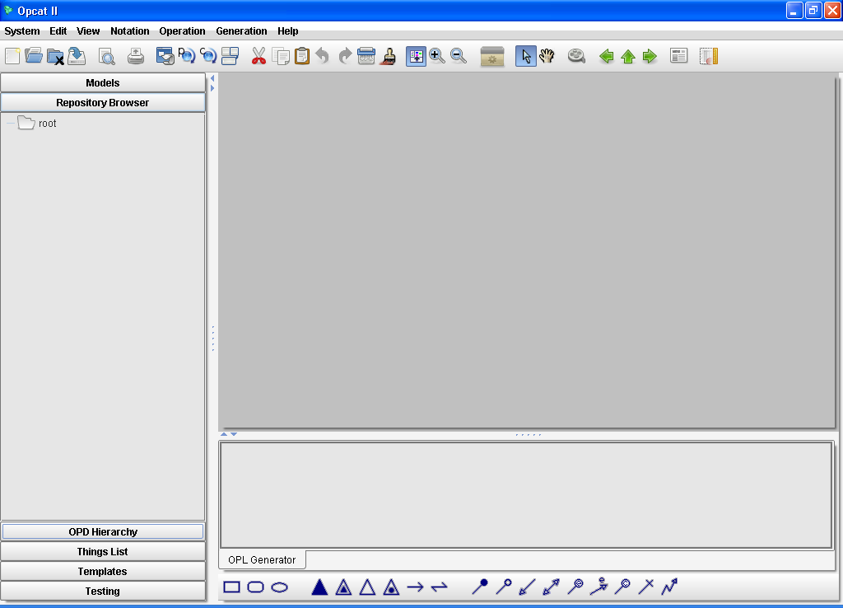
Off-line/On-line
Repository is not available while off-line
The Working Copy is available off-line and on-line
You can save files in your Working Copy, or make changes to existing ones and then commit the changes when you are back on-line
Notes:
Close OPCAT
Disconnect
Open OPCAT
Check the Repository Browser
Go to Working Copy open a model and change it
Save
Close OPCAT- to save time we check on line when OPCAT starts only
Open it and commit the file

Slide 16
Reuse and Dependency

Slide 17
Main Principle For the Design
Process
unify code
less re-write
save implementation cost \ time

Slide 18
Designer
OPCAT Server
OPCAT
Client
Repository
Model
Model
OPCAT
Client
Model
OPCAT
Client
Model
Model
Model
Working Copy

Slide 19
Designer
OPCAT Server
OPCAT
Client
Repository
Model
Model
Model
Model
OPCAT
Client
Model
Model
OPCAT
Client
Working Copy

Slide 20


Creating Dependency
Dependency = Responsibility
Exposer
User
Expose
Uses
Set Signature (API)
We created dependency
Server
Publish

Slide 21
Parent - Successor
Exposing
Declaring that a thing can be used in other models, and the conditions for it to be used. The exposed thing is called the Parent.
Examples: exposing sub-procedure, Program
Parent
Using
Successor
Successor
Successor
Using an exposed thing is by inserting a reference to the parent. The inserted reference is called successor.
Examples: call sub-procedure, execute a copied sub-routine.

Slide 22
Exposing Option
Public – declaring that this parent can be used in other models.
Example: used to declare that a sub-procedure can be used by other programs
Private – declaring this parent can be used in this model only.
Example: used when declaring a sub-procedure in the declaration part and using it inside the program several times

Slide 23
Expose for Public access
Parent
Expose
Public
EPB
Model 1
Successor
Successor
Successor
Use
UPB
Model 4
Model 3
Model 2

Slide 24
Private
Parent
Expose
Private
EPR
Successor
Successor
Successor
Use
UPR
Model 1

Slide 25
Public-Private
Parent
Expose
Private
& Public
E-PB+PR
Successor
Successor
Successor
Use
Model 2
Model 1
UPB
UPR
A thing could be exposed private and public at the same time

Slide 26
Definitions
Parent
Expose
Successor
Successor
Successor
Use
& Expose
UPR+EPB
UPR
Model 1
Successor
UPB
Model 2

Slide 27
Exposure and Usage
 | Expose | Use
Who can
What to
How to
Any designer with Read-Write rights can expose
Any designer with Read-Write rights can use from the Exposed Things List
OPM Limitations:
  Processes that can be activated independently
Domain limitations (Silverlake RPG Practices)
The designer decides according to:
Exposure Information
Model
At the Security milestone we will add administration capabilities. The Administrator will turn “proposed expose” into “expose”
At the Security milestone we will add filtering to the Exposed Things List. Filter will be set by the Administrator

Slide 28
Exposing
Expose> Expose Public/Expose Private
Preliminary Conditions:
  Model must be Added to MC
Exposure Registration:
  Private Expose – Save
  Public Expose - Commit
Post Exposure results on:
  Part of and Property of Objects
  Interface of Processes
Un -Expose
Hands-on
Notes:
Add process and object – expose public – expose private – un-expose

Slide 29
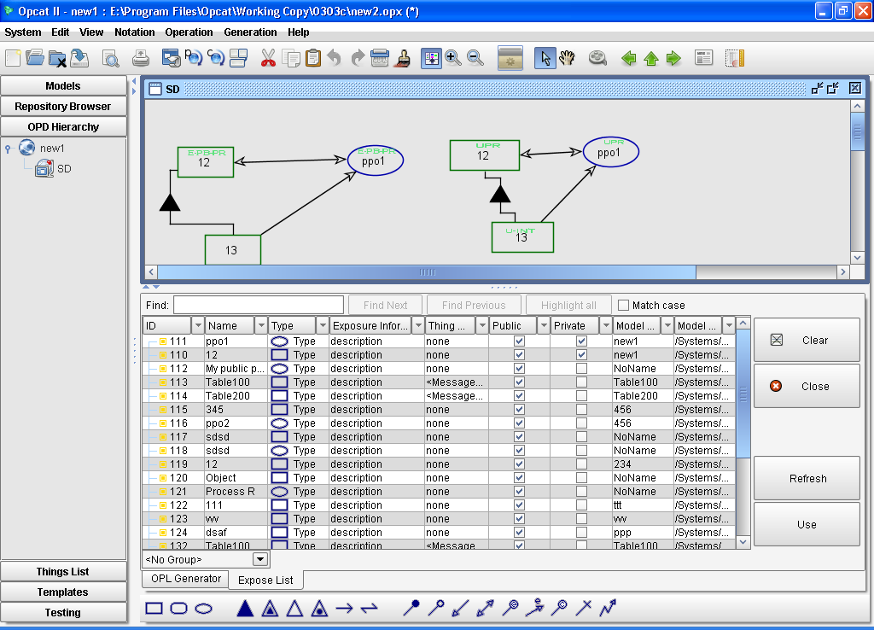
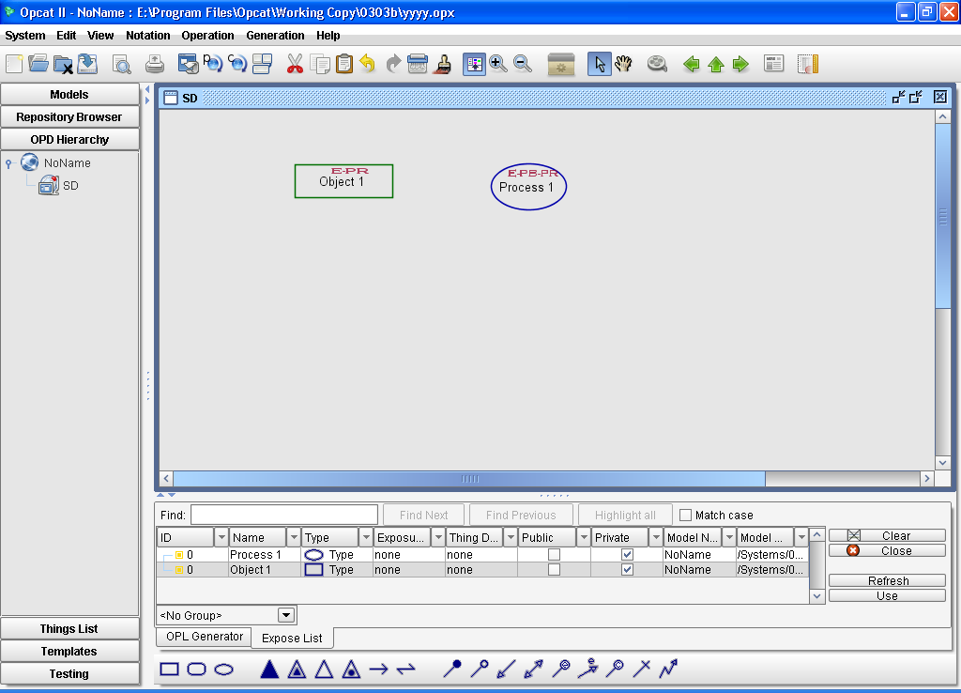
Hand-On : The Expose List
Hands-on
Notes:
Review the columns
Change information about public expose thing
Off-line On Line

Slide 30
USE
A Successor can inserted to any place at the OPD (inside an inzoom process or not)
You may make change to the Successor name and any other changes permitted by the domain you are modeling
If a Successor is marked Environmental then it means that you are planning to use the Parent in your model without any change
Hands-on
Notes:
Show advisors for regular use and for joining

Slide 31
Interface and Property
Interface of a Process
  Things that a process need in order to be activated
  Denoted in OPCAT by procedural links
Property of an Object
  Parts or characteristics of an object
  Denoted in OPCAT by aggregation and exhibition relations.

Slide 32
Interface and Property Advisors
Used on a Successor in order to insert the interface or properties of the parent
Two types of advisors :
  Interface Advisor : Set the Interface of a successor Object or Process according to the parent.
  Properties advisor : Set the properties of a successor Object or Process according to the parent
Advisors are recursive
Hands-on

Slide 33
Change Control Mechanism
?
?
Contact them via organizational communication channels
Exposer
User
Make Local Change
Un-expose
Get a list of Users
Use Again (or not)
Commit Change
Server

Slide 34
Parent Editing
We limit changes to Parent (which is used) that are most likely to adversely affect the using program
  Process
    No Interface Changes
    No Un-expose or Delete
    Can in-zoom and change the way of operation
  Objects
    No Type Changes
    No Property Changes
    No Aggregation Changes
    No Un-expose or Delete a used thing
Limitation exist only if Parent is used!
Hands-on

Slide 35
Successor Editing
The successor shall reflect the parent structure and behavior
Therefore, In-zoom, Un-fold or create-view operations on a Successor are not allowed
We recommend that Interface and existing Properties of a Successor will be added by using the Advisors only
The name of the successor may be changed as needed

Slide 36
Release and Reuse Again
By Releasing a Successor we remove the reference to the Parent thing. The released thing will still exist in the model.
A released thing can not be reused again
To reuse again use the Parent from the expose list
Use the Advisor to connect the new Successor to the Interface or Property (the Advisor ensures compatibility to the new Interface or Property)
Hands-on

Slide 37
Monitor Exposure - Usage
Show Local Successors
Show Successors
Show Parent Thing
Open Parent Model
Hands-on

Slide 38
Templates

Slide 39
Purpose
Get uniformity
Improve quality
Improve designers-programmers communication

Slide 40
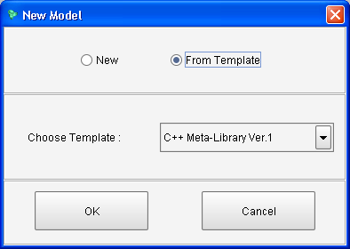
Start Off and Constructs

Slide 41
Constructs
We would like to use only part of a model as template –”wizard” to create specific operation or structure
Potential templates are stored in Templates directory
Action:
  Add as Template
  Insert
  Property/Interface Advisor
Notes:
Explain with Java Metamodel

Slide 42
Next step
Start creating Silverlake templates
Store them in the Templates Directory
At the Security delivery we will provide tool to control who is adding things to templates

